Slide 1
eFiling Overview
Arthur Laciak, eFiling Program Specialist
April 2024

Slide 2
What is eFiling?
eFiling is a CPSC initiative under which importers of regulated consumer
products will electronically file (eFile) data elements from a certificate of compliance with U.S. Customs and Border Protection (CBP), via a Partner Government Agency (PGA) Message Set.
Data stored electronically in the secure CPSC Product Registry
eFiling –
CPSC’s Modern Approach for Filing Certificate Data
Multiple options for electronically filing a PGA Message Set before a shipment arrives
Real-time data capture and streamlined processes for Trade
Easier compliance with CPSC’s certification requirements
U.S. Consumer Product Safety Commission - eFiling Overview

Slide 3
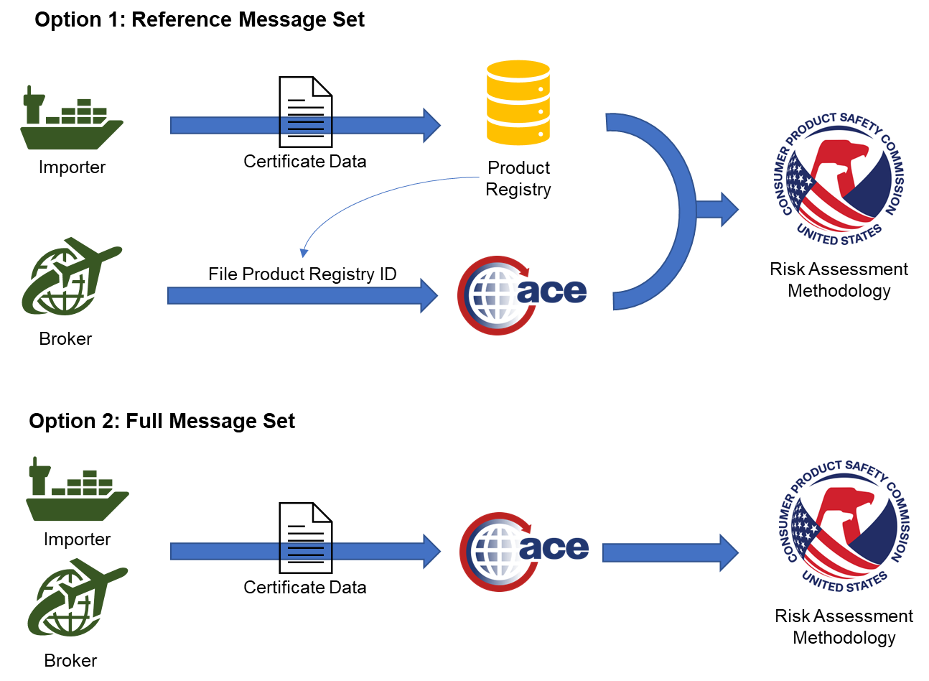

Slide 4
Why eFiling?
eFiling a Reference PGA Message Set
CPSC Product Registry
CERTIFICATE DATA
ENTRY
CBP System
CPSC System
Importer and Trade partners compile certificate data
Certificate data is entered into the CPSC Product Registry
Importer provides broker with Certificate Identifiers to file Reference PGA Message Set
Entry data and Certificate Identifiers are sent to CPSC
Reduction in risk score
Fewer holds to check for certificates
Projected Benefits
Greater focus on higher risk products
Reduced hold times
Fewer exams
Reduced costs to the importer
U.S. Consumer Product Safety Commission - eFiling Overview

Slide 5
What Must be Certified?
Products must be certified if they are…
Importers are responsible for certification.
Subject to a consumer product safety rule, ban, similar rule, standard, or regulation;
Both importers and their trade partners should have a clear understanding of which standards need to be met.
Imported for consumption or warehousing;
All trade parties must know which mandatory standards apply to the products they are importing.
Or distributed in commerce.
U.S. Consumer Product Safety Commission - eFiling Overview

Slide 6
Types of Certificates
Children's Product Certificate (CPC) - the manufacturer or importer certifies that its children's product complies with all applicable children's product safety rules (bans, standards, similar rules, or regulations). https://www.cpsc.gov/Testing-Certification/Childrens-Product-Certificate-CPC
General Certificate of Conformity (GCC) – the manufacturer or importer that its general use product (non-children’s product) comply with all appliable consumer product safety rules. https://www.cpsc.gov/Business--Manufacturing/Testing-Certification/General-Certificate-of-Conformity-GCC

Slide 7
Products Requiring a Children’s Product Certificate |  |  | Products Requiring a General Certificate of Conformity
Children’s Products: ASTM F-963 Lead Paint Lead Content Small parts Phthalates (child care) ATVs (Youth) Activity Centers Baby Changing Products Bassinets and Cradles Bedside Sleepers Bicycles (Youth) Bicycle Helmets (Youth) Bouncer Seats Booster Seats Bunk Beds Carpets and Rugs Children's Furniture Children’s Folding Chairs and Stools Clacker Balls Clothing & General Wearing Apparel Cribs Dive Sticks Electrically Operated Toys/Articles | Hand-held Infant Carriers Highchairs Frame Child Carriers Gates and Enclosures Imitation Firearms Infant Bath Seats Infant Swings Infant Walkers Mattresses – Crib and Youth Size (open Flame) Mattresses – Crib and Youth Size (smoldering) Pacifiers Paint and surface coatings Play Yards Portable Bed Rails Portable Hook-On Chairs Rattles Sleepwear sizes 0-6X Sleepwear sizes 7-14 Sling Carriers Small Parts Soft Infant and Toddler Carriers Toddler Beds Toys Toys with Magnets Wearing Apparel – Children’s Vinyl Plastic Film in Children’s Apparel |  | Architectural Glazing Artificial Emberizing Materials* ATVs Bicycles Bicycle Helmets Bunk Beds Button Cell/Coin Battery Packaging Candles with Metal Wicks Carpets and Rugs CB Antennas Cellulose Insulation Cigarette Lighters Contact Adhesives Consumer Patching Compounds* Drywall Fireworks Garage Door Openers Inclined Infant Sleep Products* | Lawnmowers Lawn Darts* Matchbooks Mattresses (open Flame) Mattresses (smoldering) Metal Candle Wicks* Multi-purpose Lighters Paint and Similar Surface Coatings* Packaging Subject to the Poison Prevention Packaging Act Portable Gas Containers Pool and Spa Drain Covers Refuse Bins* Refrigerator Doors Swimming Pool Slides Vinyl Plastic Film Wearing Apparel (Flammability) *Products subject to ban Updated 10/11/2023
ATVs Activity Centers Bassinets and Cradles Bedside Sleepers Bicycles Bicycle Helmets Bouncer Seats | Mattresses – Crib and Youth Size (smoldering) Pacifiers Paint and surface coatings Play Yards Portable Bed Rails |  | Candles with Metal Wicks | Packaging Subject to the Poison Prevention Packaging Act
Booster Seats | Rattles |  | Carpets and Rugs
Bunk Beds | Sleepwear sizes 0-6X Sleepwear sizes 7-14 |  | CB Antennas | Portable Gas Containers Pool and Spa Drain Covers
Carpets and Rugs Carriers (Infant & Toddler) | Sling Carriers Small Parts Soft Infant and Toddler Carriers |  | Cellulose Insulation | Refuse Bins
Children's Furniture Clacker Balls | Toddler Beds Toys Toys with Magnets |  | Cigarette Lighters | Refrigerator Doors
Cribs Dive Sticks | Wearing Apparel – Children’s |  | Contact Adhesives Drywall | Swimming Pool Slides Vinyl Plastic Film
Electrically Operated Toys/Articles | Vinyl Plastic Film in Children’s Apparel |  | Fireworks Garage Door Openers | Wearing Apparel
https://cpsc.gov/Business--Manufacturing/Testing-Certification

Slide 8
Certificates Must include
Identification of the finished product
Each consumer product safety rule to which the finished product has been certified
Date and place the finished product was manufactured
Date when and place where the finished product was most recently tested for compliance
Contact information for person maintaining test records
Party certifying compliance

Slide 9
2008
CPSIA requires importers to test and certify children’s and other general use products and provide certificates upon request (Codified under 16 CFR 1110).
2013
NPR published that would, among other things, require the electronic filing of certificates of compliance at the time of entry.
2016
Alpha Pilot conducted with eight participants that tested the PGA Message Set and Product Registry.
2017
Certificate Study analyzed risk potential of certificate data elements.
2020
Commission approves of Staff Briefing Package and Beta Pilot.
2023
History

Slide 10
eFiling Program Roadmap
CPSC is utilizing a phased approach to implement the eFiling Program. Phase 2 officially began with the kickoff of the eFiling Beta Pilot in October 2023.
PHASE 1
PHASE 2
PHASE 3
PHASE 4
Alpha Pilot
Beta Pilot
Final Rulemaking
Full Implementation
PGA Message Set and Product Registry Testing
8 Participants
IT development and participant testing
Over 35 Participants
Integrate eFiling rule changes
Rollout of final eFiling requirements
2016 – Completed
Fall 2023 – Summer 2024
Spring 2024 – Year End
2025
U.S. Consumer Product Safety Commission - eFiling Overview

Slide 11
eFiling Beta Pilot Timeline
The timeline below shows the key activities for Beta Pilot participants and CPSC through February 2025:
2023
2024
2025
OCT
NOV
DEC
JAN
FEB
MAR
APR
MAY
JUN
JUL
AUG
SEP
OCT
NOV
DEC
JAN
FEB
16th
eFiling Pilot Launch
Pilot Participants
eFiling and Feedback Loop
Voluntary eFiling
IT Development
(CPSC and CBP)
Product Registry Enhancements
eFiling Rulemaking
Rulemaking
System Implementation
Implementation

Slide 12
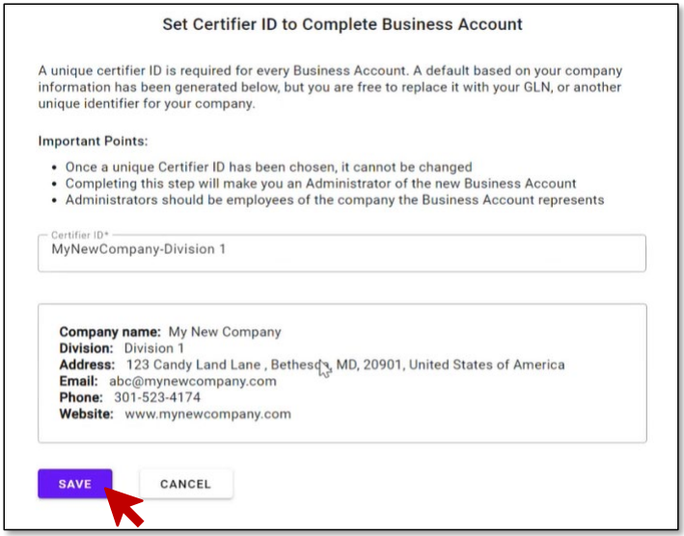
Creating a Business Account*
*Screenshots are for demonstration purposes and are subject to change as development continues

Slide 13
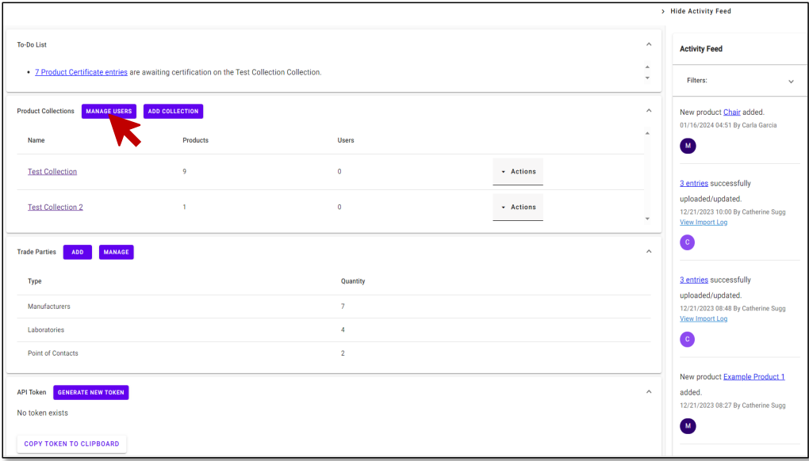
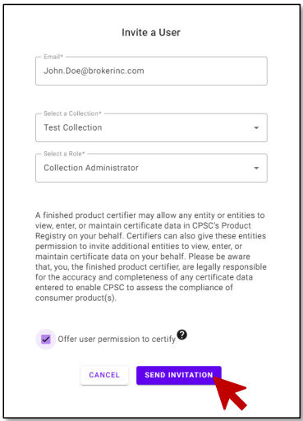
Business Account Dashboard and User Invite*
*Screenshots are for demonstration purposes and are subject to change as development continues

Slide 14
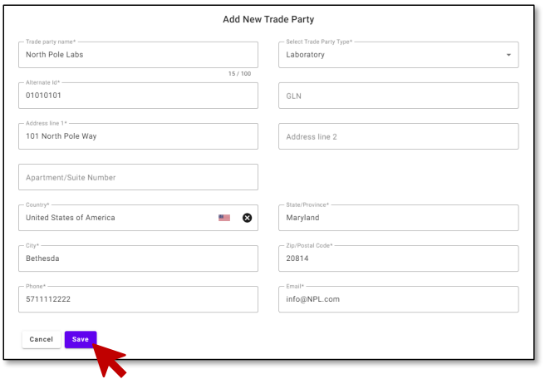
Trade Party Management*
*Screenshots are for demonstration purposes and are subject to change as development continues

Slide 15
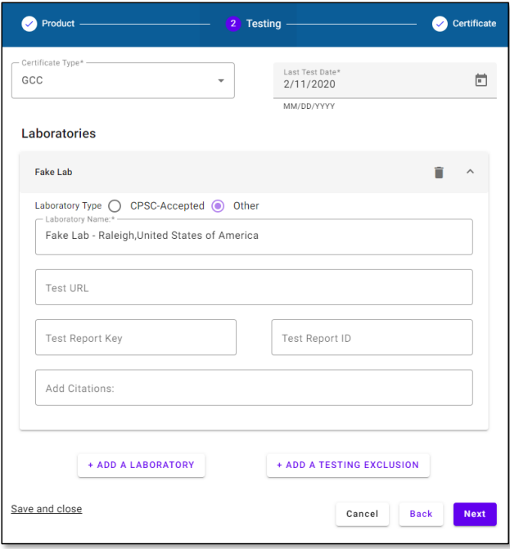
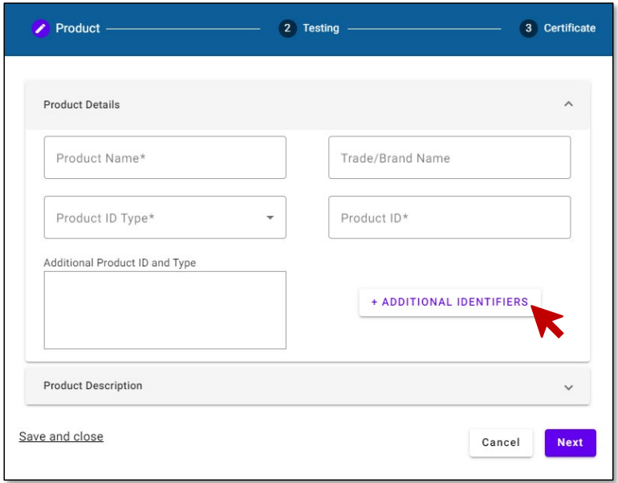
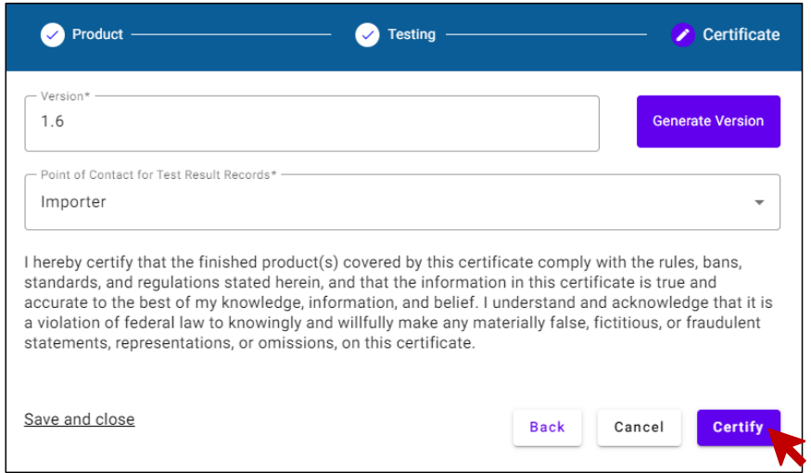
Adding Products to a Collection*
*Screenshots are for demonstration purposes and are subject to change as development continues

Slide 16
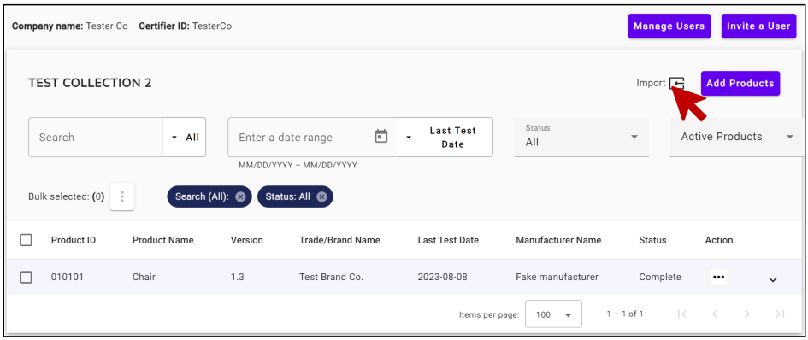
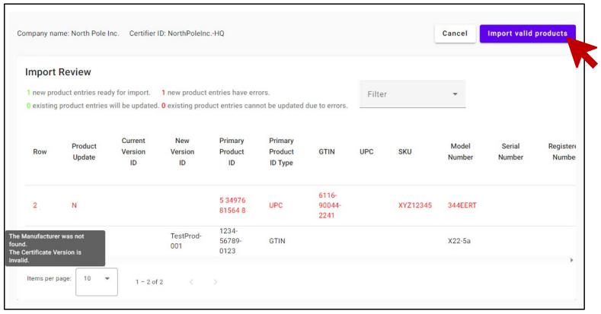
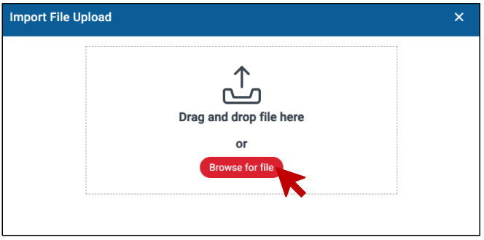
CSV Bulk Upload*
*Screenshots are for demonstration purposes and are subject to change as development continues

Slide 17
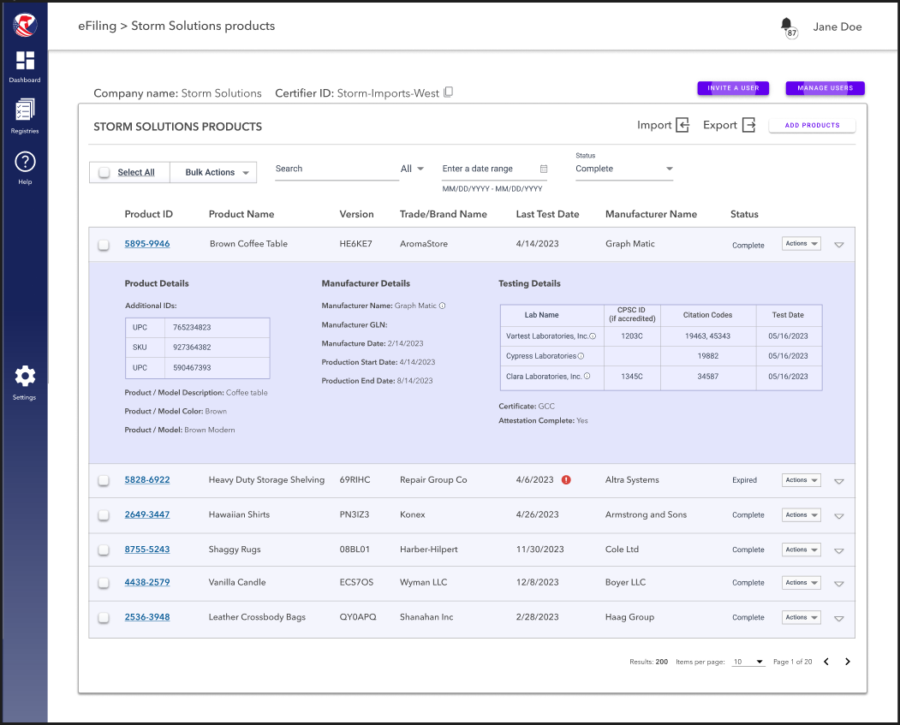
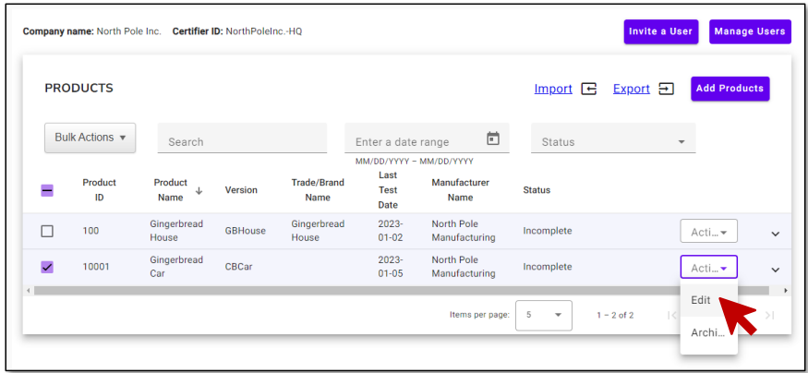
Editing Products in a Collection*
*Screenshots are for demonstration purposes and are subject to change as development continues

Slide 18
What are the eFiling Benefits?
Shorter Review Clock
Importers may see a reduction of their risk score over time based on the amount of data provided
Reductions in Risk Scores may result in reduced hold times and fewer exams which may reduce costs to the importer
Reduction in Risk Score
CPSC’s increased focus on higher risk shipments will result in fewer holds to check for certificates
Holds will be more likely performed for substantial violations rather than for certificates as certificate data will be provided ahead of time
Fewer holds may result in reduced costs to the importer
Greater Focus on Higher Risk Products

Slide 19
eFiling Support Services
CPSC has multiple channels to provide the most current, relevant, and accurate support to enable effective eFiling implementation.
Resources
Support
Visit the eFiling webpage at www.CPSC.gov/eFiling
Contact the support team at eFilingPilot@CPSC.gov
Sign up for the eFiling mailing list
Email with questions, feedback, and comments
Utilize available documents and resources
Ask technical questions for the IT team
U.S. Consumer Product Safety Commission - eFiling Overview

