Slide 1
Overview of U.S. Apparel Requirements
This presentation was prepared by CPSC Staff. It has not been reviewed or approved by the Commission and may not reflect its views.

Slide 2
The US CPSC is a federal government agency charged with protecting the public from unreasonable risks of injury or death associated with the use of consumer products under the agency's jurisdiction.
$1 Trillion
Deaths, injuries, and property damage from consumer product incidents cost the nation more than $1 trillion annually.¹
¹ https://www.cpsc.gov/s3fs-public/FY2019PBR.pdf
CPSC is committed to protecting consumers from products that pose a fire, electrical, chemical, biological, or mechanical hazard.
CPSC's work to improve the safety of the more than 15,000 types of consumer products in its jurisdiction - such as toys, cribs, power tools, cigarette lighters, textiles, and household chemicals – has contributed to a decline in the rate of deaths and injuries associated with consumer products over the past 40 years.

Slide 3
The slides used in this podcast are not a comprehensive statement of legal requirements or policy and should not be relied upon for that purpose. Moreover, with the passage of time, it may not reflect the latest information. You should consult official versions of U.S. statutes and regulations, as well as published CPSC guidance when making decisions that could affect the safety and compliance of products entering U.S. commerce. Note that references are provided at the end of the presentation.

Slide 4
Topics
Flammable Fabrics Act
Scope of Apparel Requirements
Clothing Textiles, Drawstrings
Other CPSA Requirements
Certification Requirements
Chemical Content
Tracking Labels
Small Parts
Summary of Requirements by Product Type
Resources

Slide 5
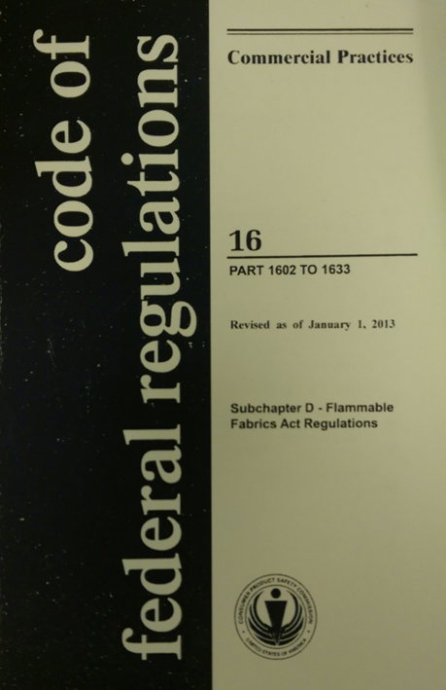
Flammable Fabrics Act (FFA)
Primary authority for CPSC-regulated textiles
Focus on flammability performance
Regulations:
Clothing Textiles
16 CFR part 1610
Vinyl plastic film
16 CFR part 1611
Children’s sleepwear
16 CFR parts 1615/1616
Carpets and rugs
16 CFR parts 1630/1631
Mattresses and mattress pads
16 CFR part 1632
Mattress sets
16 CFR part 1633

Slide 6
Clothing Textiles and Drawstrings
CPSC Apparel Requirements

Slide 7
Clothing Textiles
Applies to:
All textiles used for adult and children’s wearing apparel.
Does not apply to:
Hats, gloves, footwear, and interlining fabrics, with some exceptions (see §1610.1(c)).
Children’s sleepwear must meet a more stringent standard.

Slide 8
Clothing Textiles
Some fabrics are exempted from testing requirements:
All plain-surface fabrics greater than or equal to 88.2 g/m² (2.6 oz/yd²).
Any fabric made in whole or with a blend of the following fiber types only:
Acrylic, modacrylic, nylon, olefin, polyester, wool.
Know your fabric surface type, fiber type(s), and fabric weight

Slide 9
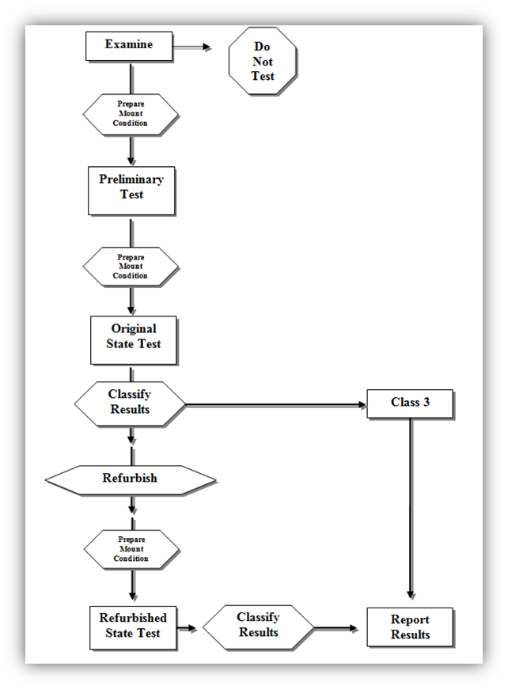
Clothing Textiles
Determine fiber type and fabric construction
Preliminary test
Prepare and condition
Test
Preliminary classification
Refurbish and repeat test
Final classification
Report

Slide 10
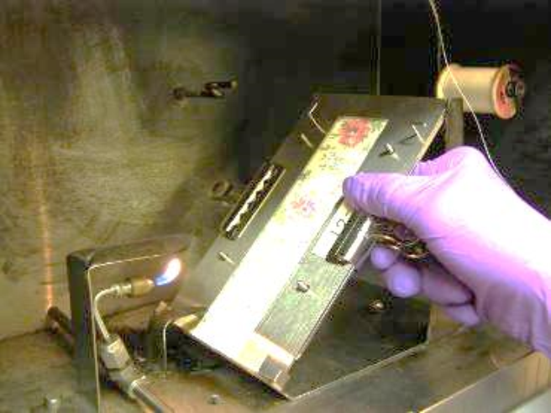
Clothing Textiles
Test Procedure
16 mm (5/8 in) flame impinges on specimen mounted at 45-degree angle for 1 second.
Record time to burn full length or until stop thread breaks.
Results of several tests are averaged, and a Class designation is assigned.

Slide 11
Clothing Textiles
Classification
Class 1
Plain and raised fiber surface fabrics
No unusual burning characteristics and are acceptable for use in clothing
Class 2
Raised fiber surface fabrics only
Intermediate flammability- use with caution
Class 3
Plain and raised fiber surface fabrics
Fabrics are dangerously flammable and CANNOT be used in wearing apparel
Classification | Plain Surface | Raised Fiber Surface
Class 1 | Average burn time > 3.5 s | Average burn time > 7.0 s OR Average burn time is 0-7 s with no base burns (SFBB)
Class 2 | N/A | Average burn time is 4-7 s with base burn (SFBB)
Class 3 | Average burn time < 3.5 s | Average burn time < 4.0 s with base burn (SFBB)

Slide 12
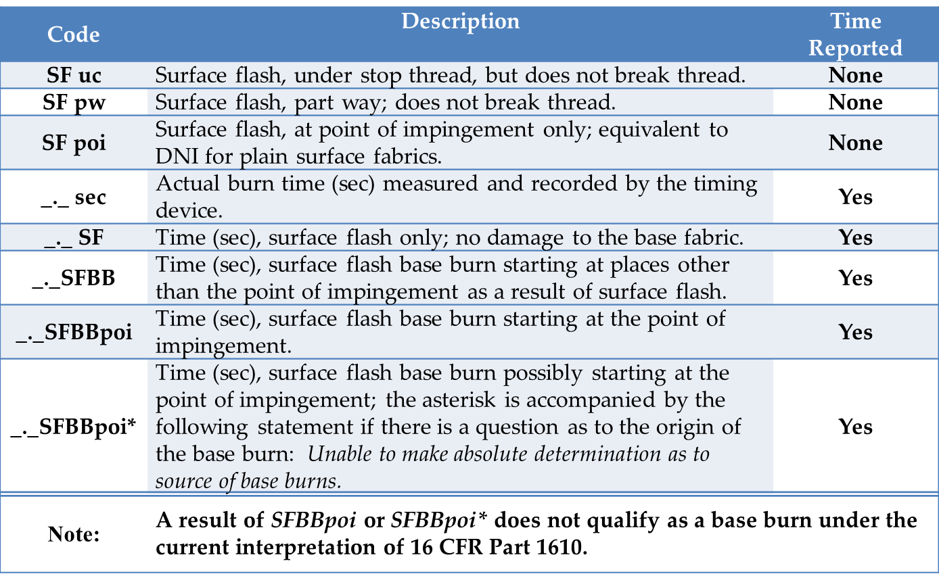
Clothing Textiles
Classification Codes (raised fiber surface only)

Slide 13
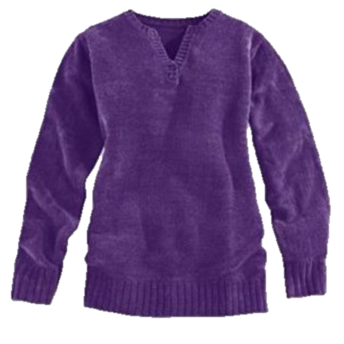
Clothing Textiles
Common Types of Noncompliant Fabrics
Lightweight, sheer fabrics of rayon and silk
Example: Scarves
Raised fiber surface cellulose or cellulose-blend fabrics
Examples: rayon and rayon-blend chenille, cotton and cotton-blend fleece, cotton terry

Slide 14
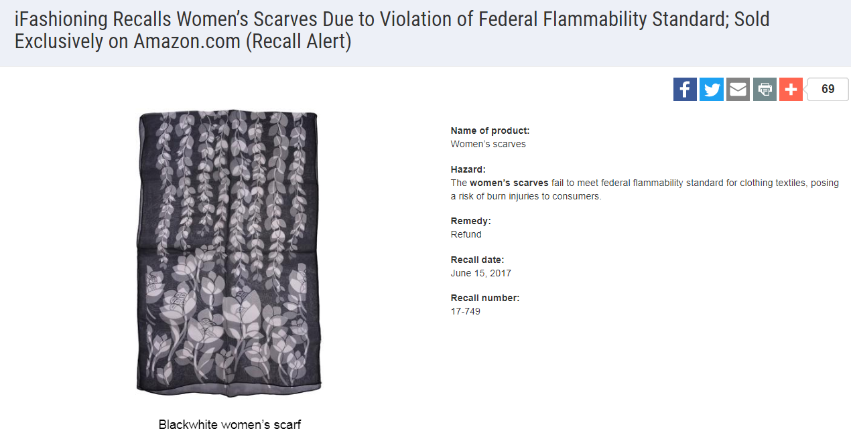
Clothing Textiles

Slide 15
Clothing Textiles
Recordkeeping (see §1610.38)
Test results, including classification
Fiber composition, fabric finish and type, and any other identifying information
Fabric swatch

Slide 16
Vinyl Plastic Film
Standard for the Flammability of Vinyl Plastic Film (16 CFR part 1611)
Applies to non-rigid, unsupported vinyl plastic film, including transparent, translucent, and opaque material used in wearing apparel subject to the FFA
Examples: disposable diapers, raincoats, some costumes
Specifies testing procedures to determine the average burn time of vinyl plastic film
May not exceed 1.2 inches per second (average)
Same recordkeeping as 16 CFR part 1610

Slide 17
Drawstrings
Young children can be seriously injured or subject to fatal entanglement if the drawstrings of the upper outerwear they are wearing catches or snags.
CPSC issued guidelines (1996) later adopted by ASTM in 1997 (ASTM F1816-97)
May 2006 letter to industry
Commission determined in 2011 that drawstrings on children’s upper outerwear present a substantial product hazard and issued a rule under 15(j) of the Consumer Product Safety Act (CPSA).
https://www.cpsc.gov/s3fs-public/pdfs/blk_media_drawstringrule.pdf

Slide 18
Drawstrings
Applies to drawstrings at the neck or waist on upper outwear.
Clothing generally intended to be worn on the exterior of other garments (ex. jackets, ski vests, anoraks, and sweatshirts).
Ties are considered drawstrings and are subject to the requirements.
Does not apply to:
Underwear, inner clothing layers, pants, shorts, swimwear, dresses and skirts. These items are not considered upper outerwear.
Belts are not drawstrings and are not subject to the requirements.

Slide 19
Drawstrings
Hood and neck area (sizes 2T through 12)
Not allowed
Use alternative closures, such as snaps, buttons, Velcro, and elastic.
Waist and bottom drawstrings (sizes 2T to 16)
Allowed, but must meet certain requirements:
Drawstring must not extend more than 3 inches from the channel when the garment is expanded to its fullest width.
Continuous drawstrings must be bar tacked or stitched through to prevent the drawstring from being pulled through its channel.
Cord locks, knots, toggles, or other attachments at the free ends of drawstrings are prohibited (even on fully retractable drawstrings).

Slide 20
Drawstrings

Slide 21
Certification, Chemical Content, Tracking Labels, Small Parts
Other CPSC Requirements

Slide 22
Certification
General Use Product
General Certificate of Conformity (GCC)
Does not require third party testing
Applies to adult apparel
Children’s Product
Children’s Product Certificate (CPC)
Requires third party testing by a CPSC-accepted laboratory for all regulations to which the product is subject
Applies to all children’s apparel
Issued by manufacturer (if domestic) or importer of record. An importer can rely on testing performed by a manufacturer to issue a certificate as long as due care is exercised and all CPSC requirements are met.

Slide 23
Chemical Content
Lead Content (FHSA)
Products designed and intended primarily for children 12 years or younger
Concentration may not exceed 100 ppm
Applies to children’s apparel and sleepwear (zippers, buttons, etc.)
Lead in Paint and Surface Coatings (CPSA)
Products designed and intended primarily for children 12 years or younger and some general use furniture
Concentration may not exceed 90 ppm
Applies to children’s general apparel and sleepwear (screen prints)
Phthalate Content (CPSA)
Children’s toys and child care articles (products used to facilitate sleeping and feeding for children 3 years or younger)
Only certain phthalates
Concentration may not exceed 0.1 %
Applies to children’s sleepwear and some apparel (bibs)
Third party testing by a CPSC-accepted laboratory is required

Slide 24
Chemical Content
Determinations
Lead
§1500.91: Certain materials will not exceed lead limits.
Textiles made from certain fiber types, dyed and undyed (including some prints).
Phthalates
§1308.2: Certain plastics with specified additives will not exceed the specified phthalates content limits.
Includes polypropylene and polyethylene.

Slide 25
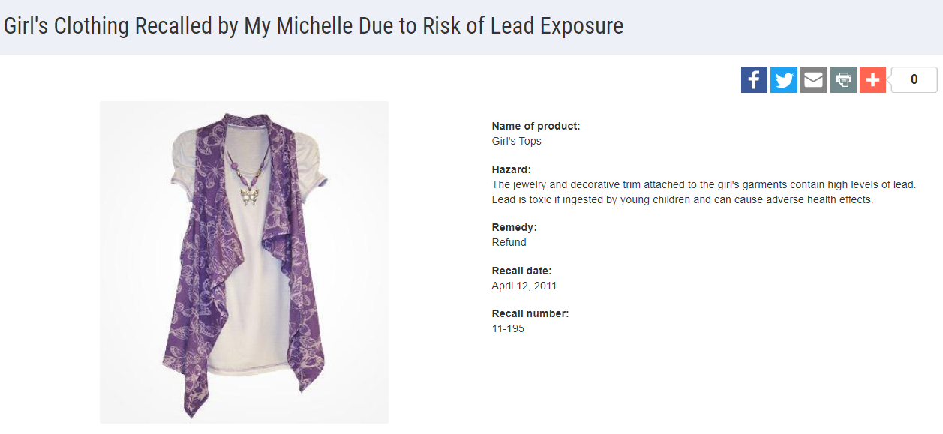
Chemical Content

Slide 26
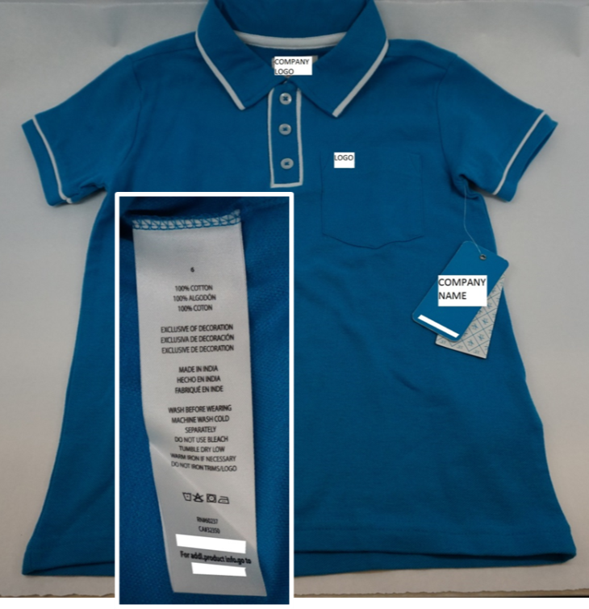
Tracking Labels
For products designed and intended primarily for children 12 years or younger, a permanent, distinguishing mark (tracking label) must:
Be affixed to the product and its packaging, visible and legible.
Provide certain identifying information:
Manufacturer or private labeler name;
Manufacturing location and date of manufacture;
Detailed information on manufacturing (ex. Batch, run, lot or style number) or other identifying characteristics; and
Any other information to facilitate ascertaining the specific source of the product.

Slide 27
Small Parts
Intended to prevent deaths and injuries to children from choking
Products intended for children under 3 years
Children’s Clothing and Accessories
Fabrics and buttons are exempted from small parts regulations and testing requirements
16 C.F.R. § 1501.3(d)
If buttons are not secure due to poor construction they may pose a substantial product hazard and need to be reported to the CPSC

Slide 28
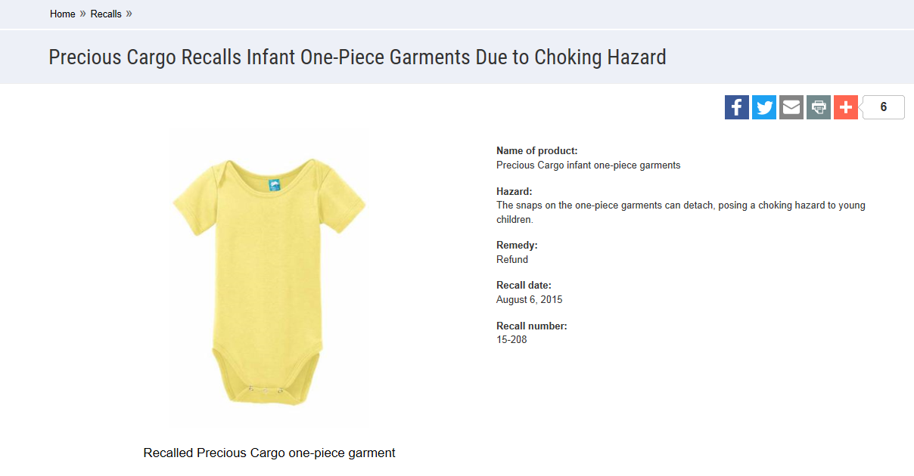
Small Parts

Slide 29
Adult and Children’s Apparel
Summarization of CPSC Apparel Requirements

Slide 30
Adult Apparel
GCC
Must meet Clothing Textile (or Vinyl Plastic Film) requirements.
Enforcement policy (March 2016)
Adult apparel exempt from testing does not require a GCC to be issued.
https://www.cpsc.gov/s3fs-public/StatementofPolicyEnforcmentDiscretionRegardingGeneralConformityAdultWearingApparelExemptfromTesting.pdf

Slide 31
Children’s Apparel
CPC and third party testing by a CPSC-accepted laboratory
Clothing Textile (or Vinyl Plastic Film)
Lead content (zippers, buttons)
Lead in paint or surface coating (screen printing)
Phthalate (bibs)
Tracking label
Drawstring; does not require certification, but standard must be met.

Slide 32
Questions?
Submit your questions in English or Spanish to:
CPSCenlasAMERICAS@CPSC.GOV

Slide 33
Resources

Slide 34
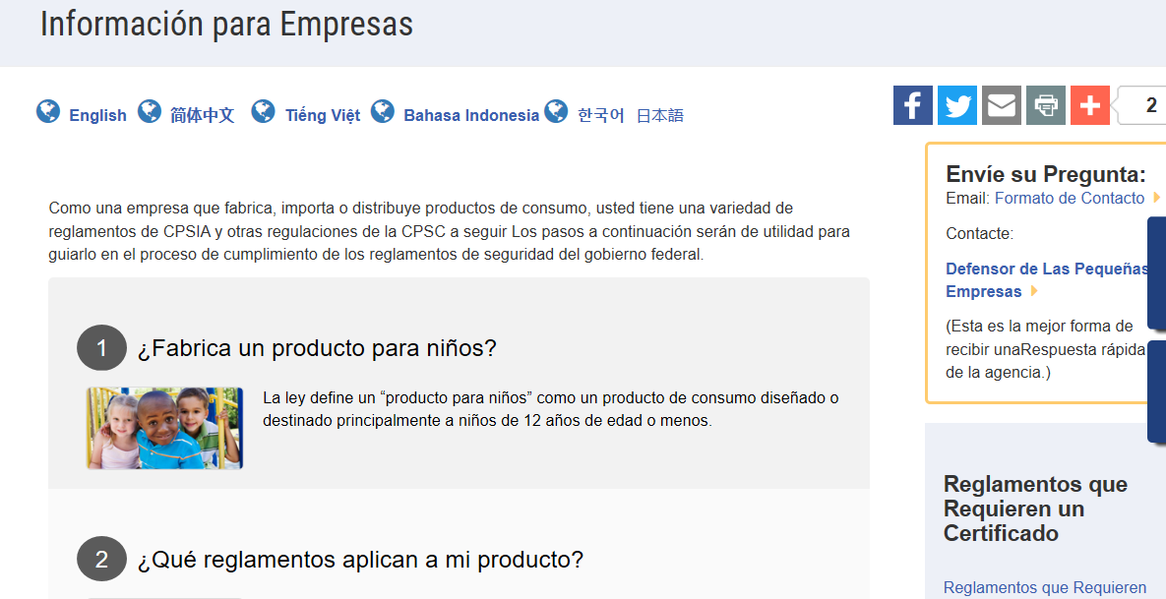
https://www.cpsc.gov/es/Business--Manufacturing/Business-Education
Resources in Spanish at cpsc.gov

Slide 35
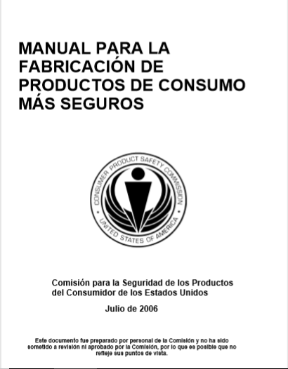
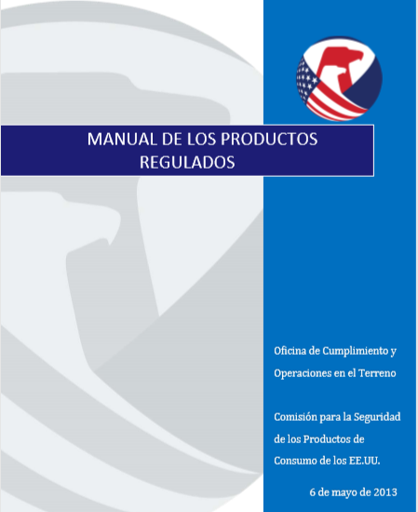
Resources in Spanish at cpsc.gov
https://www.cpsc.gov/s3fs-public/pdfs/blk_pdf_handbookspanishjul06.pdf
https://www.cpsc.gov/s3fs-public/TheRegulatedProductsHandbookSp.pdf

Slide 36
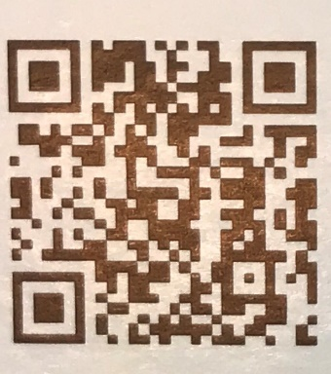
http://business.cpsc.gov
Online tool designed specifically to help businesses comply with federal consumer product safety requirements.
Asks a series of guided questions, and based on the answers produces a downloadable (PDF) report.
Provides customized guidance with links to product safety regulations that may apply to the product and important information on labeling, certification and testing requirements.

Slide 37
Regulatory Robot
Regulatory Robot is a tool to help identify which mandatory standards are applicable
Does not give details of requirements within a specific standard
User inputs product features
Regulatory Robot outputs list of standards and requirements
User references source documents for specific requirements

Slide 38
Regulations
https://www.cpsc.gov/Regulations-Laws--Standards/Statutes/Flammable-Fabrics-Act/
Laboratory Test Manual for 16 CFR Part 1610: Standard for the Flammability of Clothing Textiles
English: https://www.cpsc.gov/s3fs-public/Flammability%20of%20Clothing%20Textiles%20Test%20Manual_1610.pdf
Laboratory Test Manual for 16 CFR Parts 1615 and 1616: Standard for the Flammability of Children’s Sleepwear
English: https://www.cpsc.gov/s3fs-public/Flammability%20of%20Children's%20Sleepwear%20Test%20Manual_1615_1616.pdf
Apparel Resources
(In English)

Slide 39
Definition of children’s product – 16 CFR Part 1200
Certificates of conformity – 16 CFR Part 1110
Third-party testing – 16 CFR Parts 1107, 1109, and 1112
Tracking information – 15 USC § 2063(a)(5)
Mandatory reporting requirements – 15 USC §2064
CPSC Business Resources
(In English)
CPSC-Accepted Laboratories Search Page:
www.cpsc.gov/LabSearch

Slide 40
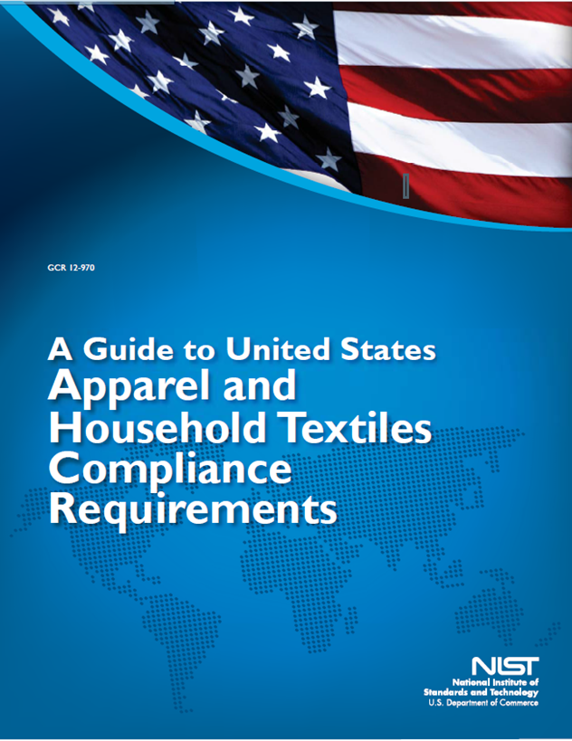
Apparel Resources
(In English)
https://nvlpubs.nist.gov/nistpubs/ir/2016/NIST.IR.8115.pdf

